Slide 1
Sales and Profit Optimization for Retail Decision Support
Sahanabanu Shaikh Student ID: 501342966 CIND820 – Big Data Analytics Project

Slide 2
Problem:
• Discounts increase sales but reduce profit
• High sales ≠ High profitability
• Lack of data-driven pricing decisions
Goal:
Improve profit-focused decision-making using data.

Slide 3
Research Questions:
1. What factors influence profitability in retail transactions?
2. Can profit be predicted accurately using historical data?
3. Can transactions be classified as profitable or loss-making?

Slide 4
Dataset: Global Superstore
• 51,290 transactions
• 27 variables
• Transaction-level data
Each row represents a transaction with details like sales, profit, discount, and quantity. Additional variables include product category and region.

Slide 5
Methodology:
1. Data Cleaning
2. Exploratory Data Analysis
3. Feature Selection
4. Model Development
5. Model Evaluation

Slide 6
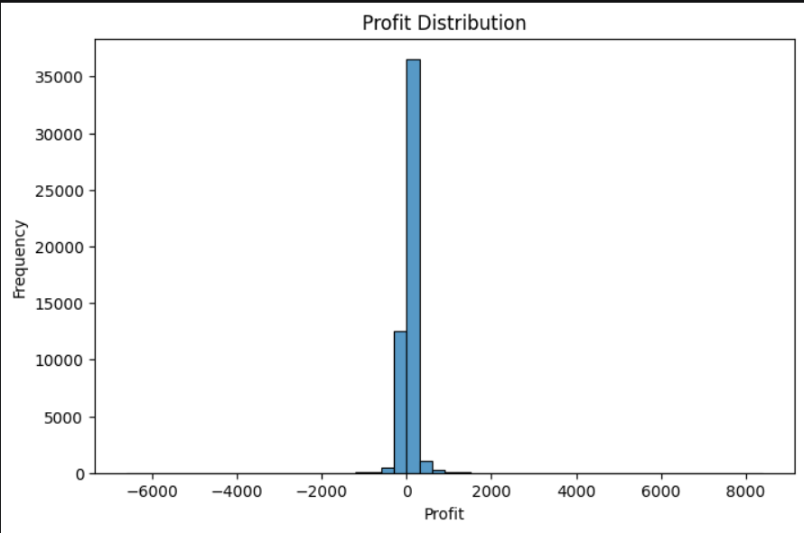
Profit Distribution
• Highly variable across transactions
• Includes both large gains and losses
Insight: This shows that profitability is
not consistent.

Slide 7
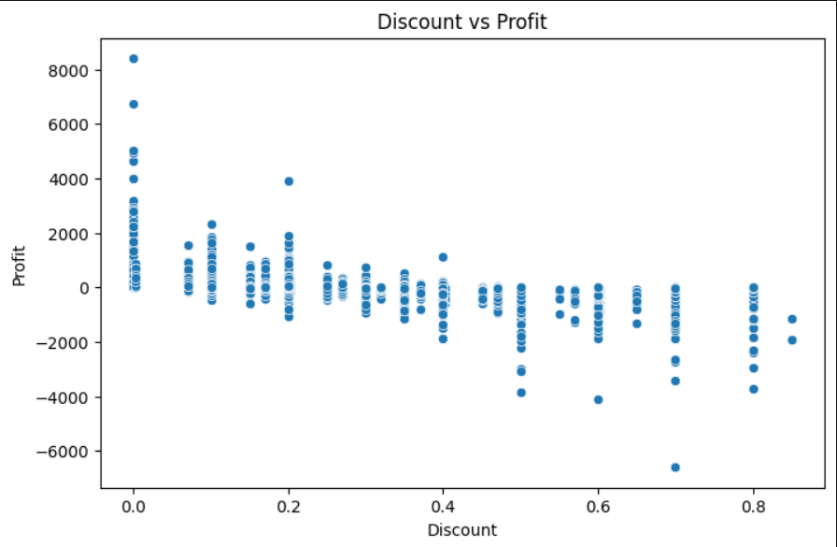
Discount vs Profit
• Strong negative relationship between discount and profit.
• Higher discount → lower profit
This highlights the risk of aggressive
discounting strategies.
Insight: Discount is a major driver of
profit loss

Slide 8
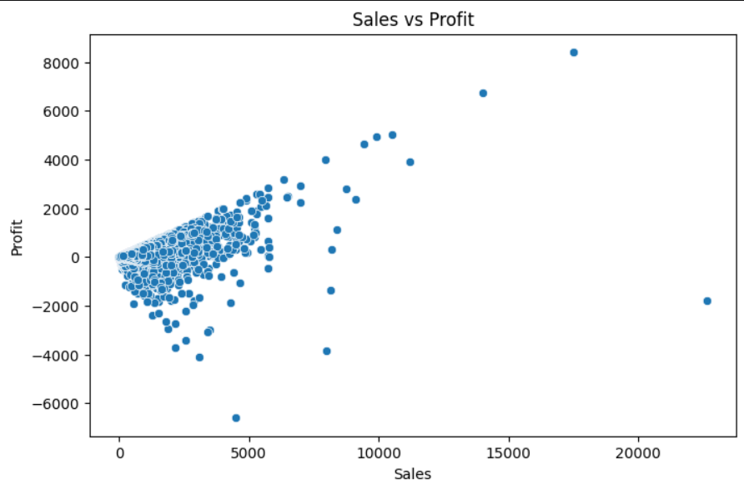
Sales vs Profit
• No strong positive relationship
• High sales ≠ high profit
Insight: This shows that revenue alone is
not a good indicator of
performance.

Slide 9
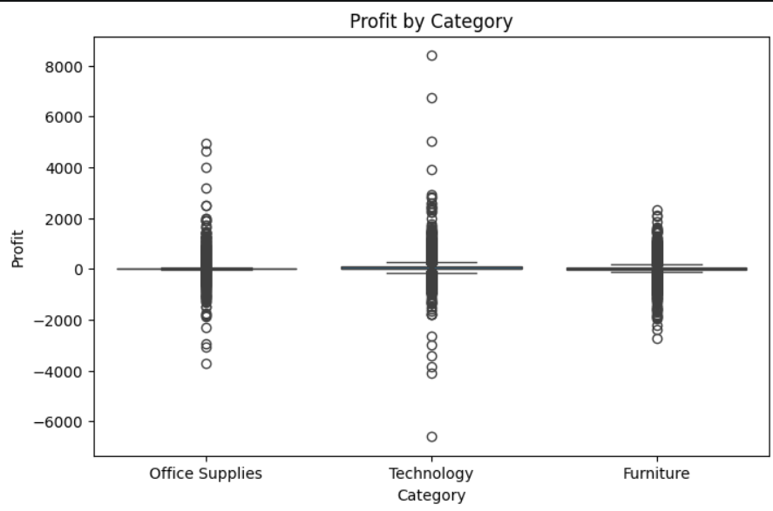
Sales by Category • Technology → highest sales • Office Supplies → moderate • Furniture → lower sales Insight:Product category affects performance

Slide 10
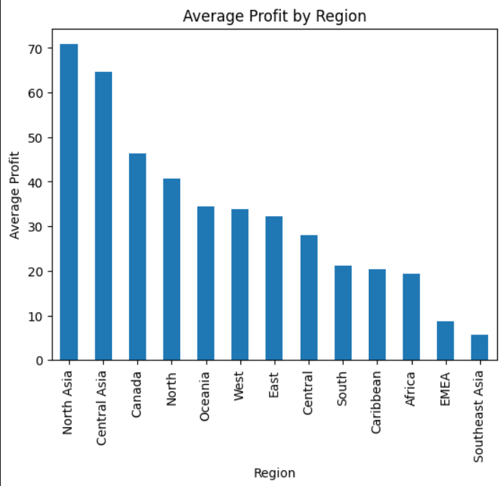
Sales by Region • Sales vary across regions • Some regions outperform others Insight: Geographic factors influence performance

Slide 11
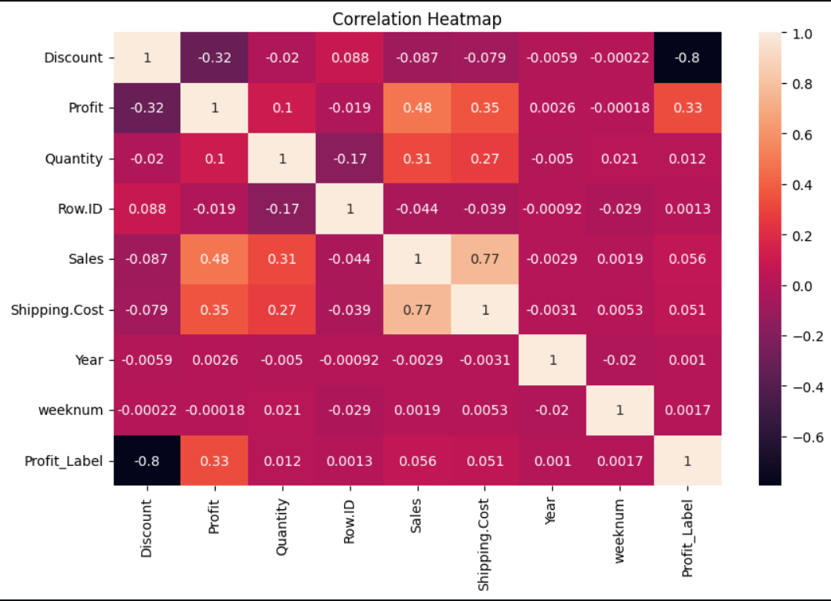
Correlation Heatmap • Discount negatively correlated with profit • Sales moderately related to profit • Quantity has weak relationship Insight: Relationships exist but are not purely linear

Slide 12
Models Used:
Regression:
• Linear Regression
• Decision Tree
Classification:
• Logistic Regression
Baseline models are used to compare performance.

Slide 13
Regression Results:
Linear Regression:
• R² ≈ 0.17 (weak)
Decision Tree:
• R² ≈ 0.51 (better)
Conclusion:
Profit relationships are nonlinear

Slide 14
Classification Results:
Baseline Accuracy: ~74%
Logistic Regression:
• Accuracy: 91.8%
• Precision: 91.9%
• Recall: 97.5%
Insight:
Strong classification performance

Slide 15
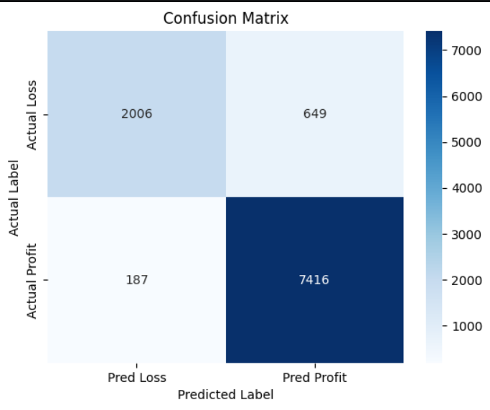
Confusion Matrix
• False Positive → risky decision
• False Negative → missed opportunity

Slide 16
Key Findings:
• Discount significantly reduces profit
• Profit depends on multiple interacting factors
• Nonlinear models outperform linear models
• Classification helps identify high-risk transactions

Slide 17
Limitations:
• Limited features
• No causal analysis
• Possible overfitting
• Missing cost/customer data

Slide 18
Future Work:
• Add cost & customer data
• Use advanced models
• Improve feature engineering
• Time-based validation

Slide 19
Business Value:
• Supports pricing decisions
• Reduces loss-making transactions
• Improves profitability focus
• Enables data-driven strategies

Slide 20
Conclusion:
• Profit ≠ Sales
• Discount is the strongest driver of profit
• Nonlinear models improve prediction
• Predictive analytics supports decision-making
• Results should be used with caution

Slide 21
Thank You

